Slide 2
Microsoft Project 2010 Ignite - Introduction
Christophe Fiessinger & Jan Kalis
Senior Technical Product Manager
Microsoft Corporation

Slide 3
Agenda
Project 2010 Ignite Overview
Project 2010 Overiew
Project 2010 Resources

Slide 4
Project 2010 Ignite Overview

Slide 5
Project 2010 Ignite Technical Readiness prior to launch
Objective | Build skilled Project 2010 MCS and Partner SI IT Pro and Developer capacity by RTM through Microsoft led training
Audience | Experienced EPM architects, administrators, and developers with hands on experience deploying, operating and customizing EPM 2007
Content & Delivery | 3 day training. Focus on “delta” training (what’s new compared to 2007). Concentrate on topics that you need to understand in order to get Project Server 2010 deployed. Foundation for additional training content and certification after launch
Modalities
Ignite Tour
(Nov 2009 – March 2010)
Instructor Led Training
8 cities worldwide
Ignite Online
(2010 Q2)
Hosted online content available for self-paced learning
Notes:
Goal
Provide you with preliminary Project 2010 training based on Beta version!
Expectations
Not Project Conference 2009, nor SharePoint Conference 2009!
No hands on training but Project 2010 Demo Image is available

Slide 6
Project 2010 Ignite WW Tour
Ignite - Europe - France Nov 17 - Nov 19
Ignite - Latin America - Brazil Dec 8 - Dec 10
Ignite - Asia Pacific -Australia Feb 9 - Feb 11
Ignite - North America - Seattle Mar 17 - Mar 19
December
January
February
March
Microsoft Project 2010 - Worldwide Technical and Sales Readiness Tour
Are you Project 2010 Ready? http://www.microsoft.com/project
Work Management Solutions for Individuals, Teams, and the Enterprise
Ignite - Europe - Czech Republic Nov 4 - Nov 6
Ignite - Latin America - Mexico Dec 1 - Dec 3
Ignite - Asia Pacific - Singapore Feb 2 - Feb 4
Ignite - North America - Virginia Mar 3 - Mar 5
Location (Region/Country/City) | Dates
Europe - Czech Republic, Prague | November 4-6, 2009
Europe - France, Paris | November 17-18, 2009
Latin America - Mexico, Mexico City | December 1-3, 2009
Latin America - Brazil, Sao Paulo | December 8-10, 2009
Asia Pacific - Singapore | February 2-4, 2010
Asia Pacific - Australia, Sydney | February 9-11, 2010
North America – Reston, Virginia | March 3-5, 2010
North America – Seattle, Washington | March 17-19, 2010

Slide 7
Project 2010 Overview

Slide 8


Project 2010 Investment Areas Work Management Solutions for Individuals, Teams and the Enterprise

Slide 9
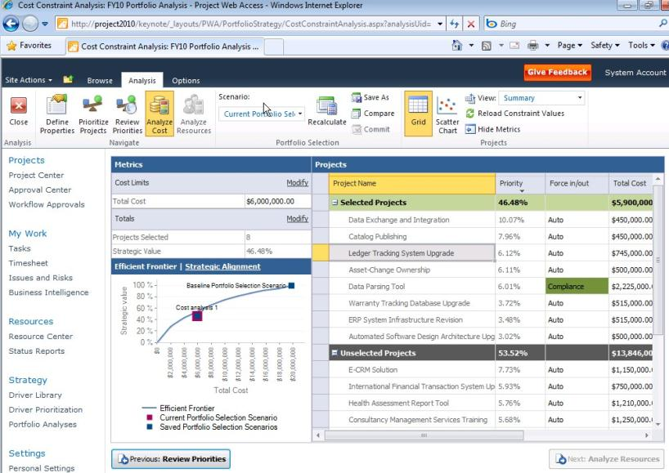

Microsoft Project 2010 Unified Project and Portfolio Management
Single server with end to end PPM capabilities
Flexible project capture and initiation
Enhance governance through workflow
Powerful portfolio selection analytics
Unified Project and Portfolio Management
Simple and Intuitive User Experience
Scalable and Connected Platform
Enhanced Collaboration and Reporting
Notes:
Time 10

Slide 10
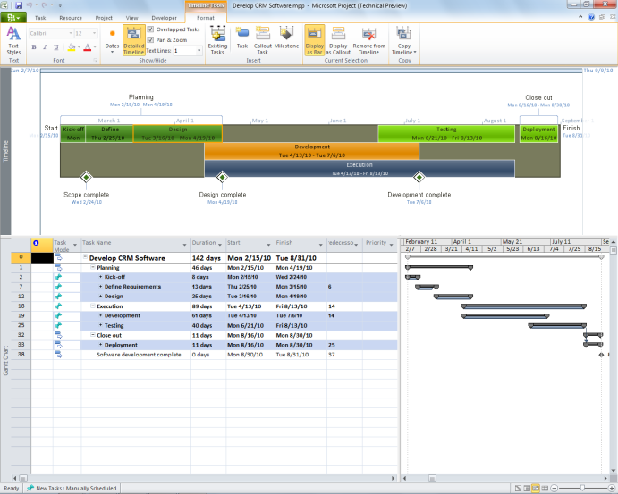
Microsoft Project 2010 Simple and Intuitive User Experience
Ribbon, Backstage view
Intuitive Excel-like behavior
Timeline & Team Planner views
Web-based project editing
Unified Project and Portfolio Management
Simple and Intuitive User Experience
Scalable and Connected Platform
Enhanced Collaboration and Reporting
Notes:
Time 25

Slide 11



Microsoft Project 2010 Enhanced Collaboration and Reporting
Built on SharePoint Server 2010
Connect teams with SharePoint Sync
Better time and status reporting
Easily create reports and dashboards
Sites
Composites
Communities
Insights
Content
Search
Unified Project and Portfolio Management
Simple and Intuitive User Experience
Scalable and Connected Platform
Enhanced Collaboration and Reporting
Notes:
50

Slide 12
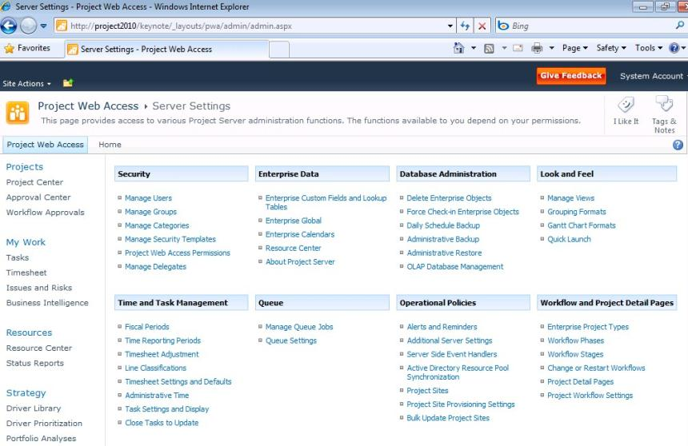





Microsoft Project 2010 Scalable and Connected Platform
Extend Interoperability
Simplified Administration
Rich Platform Services
Developer Productivity
Unified Project and Portfolio Management
Simple and Intuitive User Experience
Scalable and Connected Platform
Enhanced Collaboration and Reporting
Notes:
65

Slide 13

Choose the Right Tools that Can Evolve with You Work Management Solutions for Individuals, Teams and the Enterprise
IT Mgt · NPD · Cap Projects · Govt
Project & Portfolio Management
Enterprise
Workgroup Collaboration and Reporting
Project Server 2010
(Built on SharePoint® Server)
Team
Project Professional Synch to SharePoint
Web-Based Project Editing (Project Server)
Level of Collaboration
Project Managers
Project Professional
SharePoint Task Lists
Individual
Low
Medium
High
Level of Complexity

Slide 14
Project 2010 Resources

Slide 15

- Resources
Product information and trial download
http://www.microsoft.com/project
Project Team Blog http://blogs.msdn.com/project
Interactive content - Videos & Sessions & Webcasts
http://www.microsoft.com/showcase/en/US/channels/microsoftproject
http://www.microsoft.com/events/series/epm.aspx
IT Professional related
TechCenter @ TechNet http://technet.microsoft.com/ProjectServer
Admin Blog http://blogs.technet.com/projectadministration
Developer related
Developer center @ MSDN http://msdn.microsoft.com/Project
Programmability blog http://blogs.msdn.com/project_programmability
Additional questions? Project 2010 Forums!
http://social.msdn.microsoft.com/Forums/en-US/category/projectserver2010,projectprofessional2010
SharePoint 2010
http://sharepoint.microsoft.com
FORUMS
Project Professional 2010
General Questions and Answers
Project Server 2010
General Questions and Answers
Setup, Upgrade, Administration and Operation
Customization and Programming

Slide 16

Project 2010 Solution Demo Image
The Project 2010 Solution demo provides a comprehensive overview of the new and existing capabilities included in Microsoft Project Professional 2010 and Microsoft Project Server 2010. The demo follows the life of a software development project from inception through to completion.
EPM Solution demo includes:
PPM Governance
Portfolio Selection & Analytics
Detailed Planning
Project & Portfolio Execution
Hosted - http://go.microsoft.com/?linkid=9713654
Download - http://go.microsoft.com/?linkid=9713956
Please do follow instructions included in the documentation.
Recommended Hardware/Software
8GB RAM
Solid State Drive (SSD)
Windows Server 2008 R2 64 bit (Hyper-V)
Feedback to proj2010@microsoft.com and title the email “Demo Feedback”.
Distributed to partners and customers since Beta.

Slide 17

© 2009 Microsoft Corporation. All rights reserved. Microsoft, Windows, Windows Vista and other product names are or may be registered trademarks and/or trademarks in the U.S. and/or other countries.
The information herein is for informational purposes only and represents the current view of Microsoft Corporation as of the date of this presentation. Because Microsoft must respond to changing market conditions, it should not be interpreted to be a commitment on the part of Microsoft, and Microsoft cannot guarantee the accuracy of any information provided after the date of this presentation. MICROSOFT MAKES NO WARRANTIES, EXPRESS, IMPLIED OR STATUTORY, AS TO THE INFORMATION IN THIS PRESENTATION.

